Slide 1

Lakhmi Chand Institute of Technology
Major Project Synopsis Presentation
by
Rohit Kumar, Nikita Kumar, Neha Patil
B.Tech | Computer Science and Engineering | 6th Semester

Slide 2
ViZONE
The-AI ROBOT
Based on CV

Slide 3
Content
Introduction of Project
Front End
Back End
Conclusion

Slide 4
Introduction of Project
In today's hectic life everybody wants their job to get done quickly. Mostly in the industrial areas, the manufacturer always wants to get the things ready within less amount of time and with Efficiency. But at the same time, it's quite impossible for humans to get the required output in a limited amount of time with less ManPower. So to increase the productivity and efficiency of the human need, we tried to make this Ai based robot Which is named as ViZone.

Slide 5




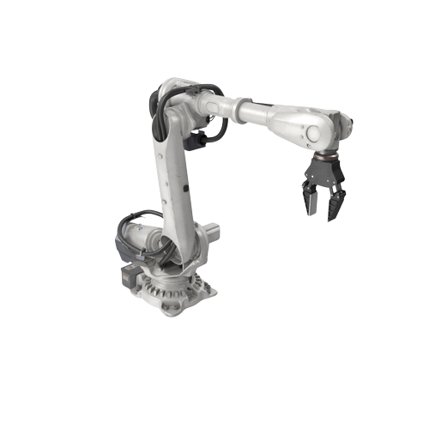

Introduction of Project

Slide 6



Front End
Programming Languages :-
Design and Development: -

Slide 7

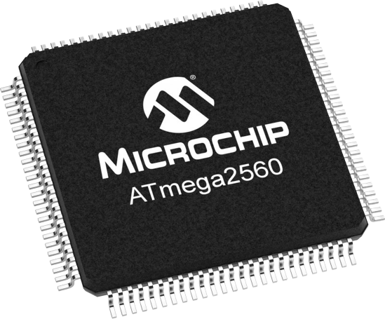
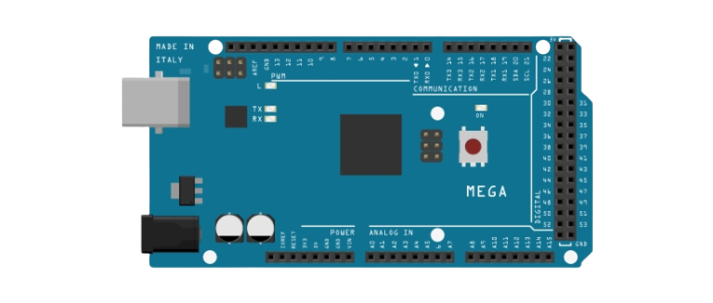
Back End
Programming Languages :-
Microcontroller and ICs: -

Slide 8
Conclusion
As vision technology continues to expand, the time is not far when the vision industry will take the first position as a solutions purveyor for real-world problems. It is not only limited to the industrial Areas it can also be useful as a domestic gadget.Such as helping hand in household,It can be also used in Agricultural sectors. This kinds of Robots are also Useful for a healthy and hygiene Food Packaging Factory.

Slide 9
Thank You

